Slide 1
Online Retail Customer Segmentation-
Unsupervised Learning: Clustering
Anushree Kajavadekar

Slide 2
What is unsupervised learning?
Unsupervised learning, also known as unsupervised machine learning, uses machine learning algorithms to analyze and cluster unlabeled datasets. These algorithms discover hidden patterns or data groupings without the need for human intervention. Its ability to discover similarities and differences in information make it the ideal solution for exploratory data analysis, cross-selling strategies, customer segmentation, and image recognition.

Slide 3
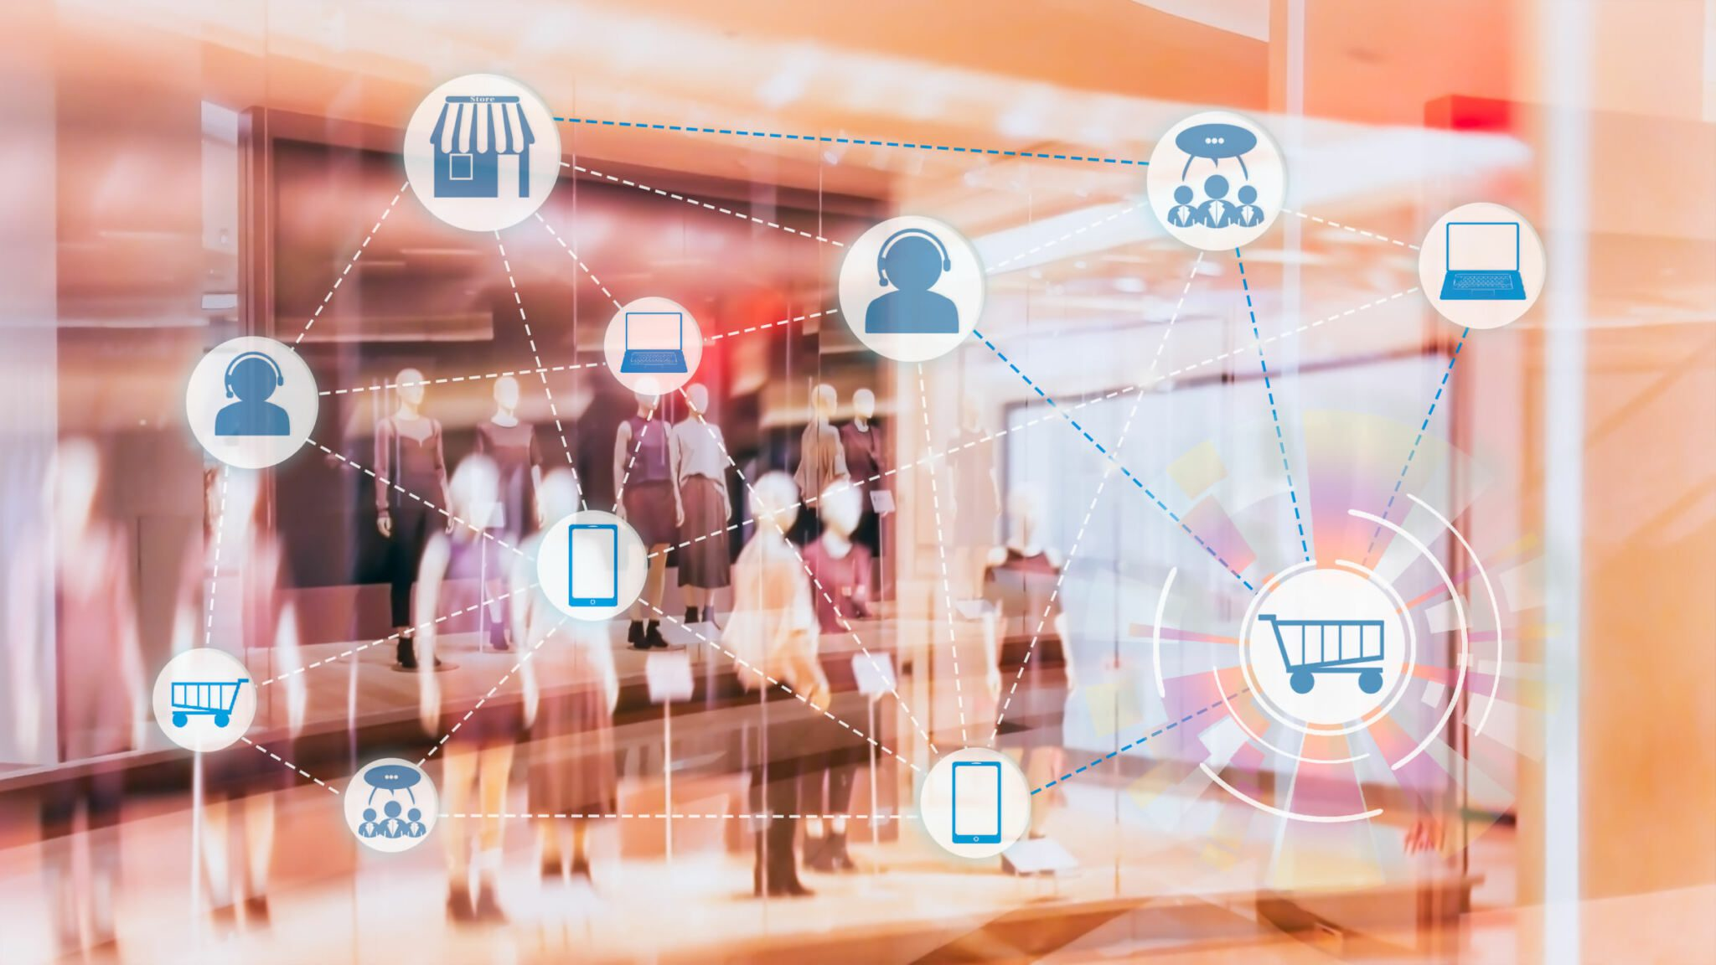
Outline
1.Problem Statement
2.Data Summary
3.Data Preparation
4. EDA
5. Data Modelling
6.Challenges
7.Conclusion

Slide 4
Problem Statement
We will use the Online Retail Data of the very popular transactional dataset.
This is a transactional data set which contains the transactions occurring between 01/12/2010 and 09/12/2011 for the UK-based and registered non-store online retail firm and contains realistic customer Transaction information in a commonly used format in Industry.

Slide 5
Data Summary
Attribute Information:
Data set has 541909 rows and 8 columns
InvoiceNo: Invoice number. Nominal, a 6-digit integral number uniquely assigned to each transaction. If this code starts with letter 'c', it indicates a cancellation.
StockCode: Product (item) code. Nominal, a 5-digit integral number uniquely assigned to each distinct product.
Description: Product (item) name. Nominal.
Quantity: The quantities of each product (item) per transaction. Numeric.
InvoiceDate: Invoice Date and time. Numeric, the day and time when each transaction was generated.
UnitPrice: Unit price. Numeric, Product price per unit in sterling.
CustomerID: Customer number. Nominal, a 5-digit integral number uniquely assigned to each customer.
Country: Country name. Nominal, the name of the country where each customer resides.

Slide 6
Data Cleaning
It is the process of finding the inaccurate, incorrect and irrelevant or missing part of a data and then, modifying the data according to our necessity.
There are 541909 rows and 8 columns in above dataset. Dataset has missing value on Description & CustomerID. After checking, we can see there are 5268 duplicate values.
So I removed null and duplicate values. After removing null and duplicate values in our dataset. It reduces to (401604, 8)
After checking further, there are some InvoiceNo which starts with “c” which indicates cancellation so I have dropped them.
Now We have 392732 rows and 8 columns after processing and cleaning the data.

Slide 7
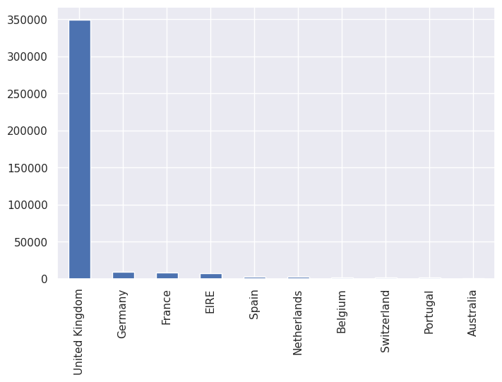
Exploratory Data Analysis
Top countries having most of the customers
Plot shows the top countries having most of the customers.
We can see that majority of the customers are from the United Kingdom.

Slide 8
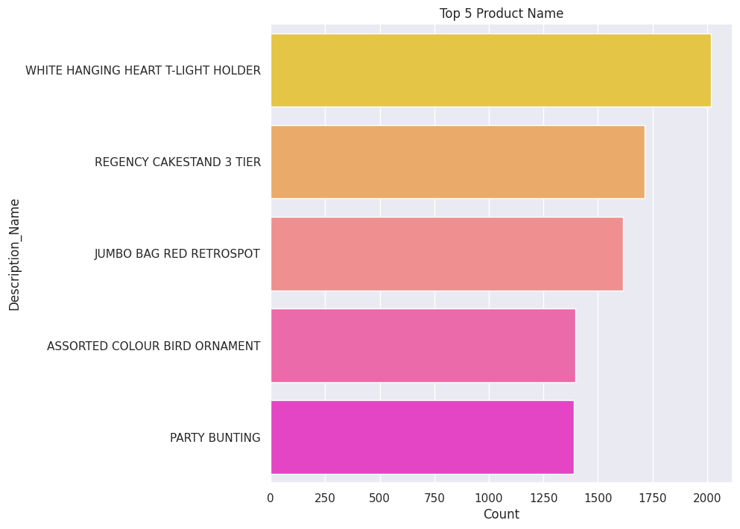
Top Products
WHITE HANGING HEART T-LIGHT HOLDER
REGENCY CAKESTAND 3 TIER
JUMBO BAG RED RETROSPOT
ASSORTED COLOUR BIRD ORNAMENT
PARTY BUNTING

Slide 9
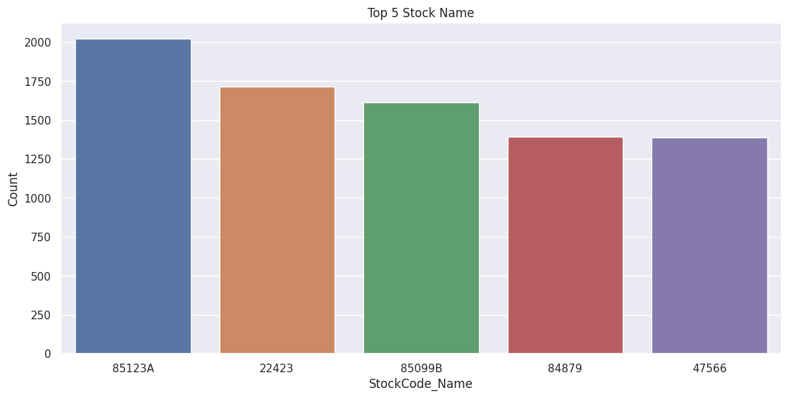
Top Stock Names
Top 5 Stock names are:
1.85123A
2.22423
3.85099B
4.47566
5.20725

Slide 10
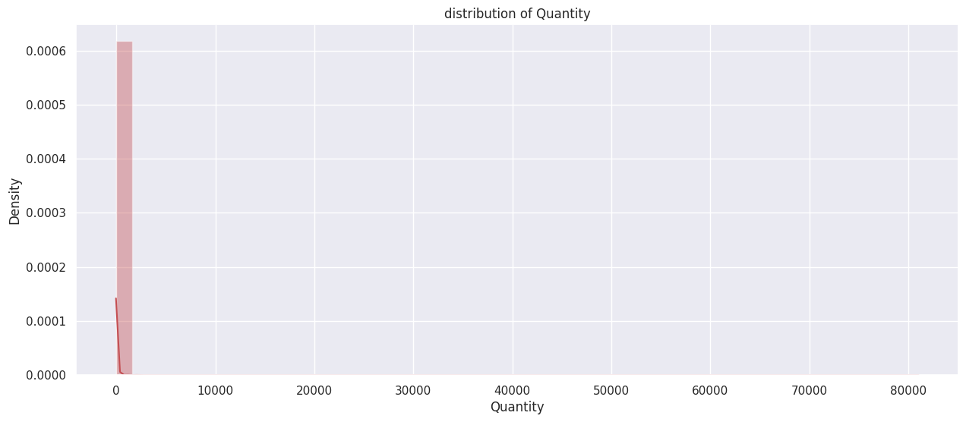
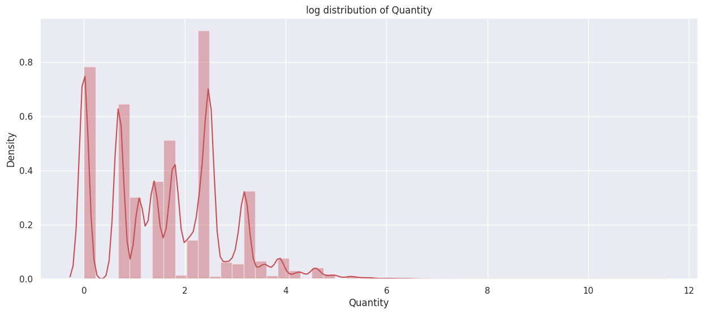
Data Distribution
Here we can see that its a Positively skewed (or right-skewed) distribution. It is a type of distribution in which most values are clustered around the left tail of the distribution.
Here, we can see the data after transforming skewed distribution to symmetrical distribution

Slide 11
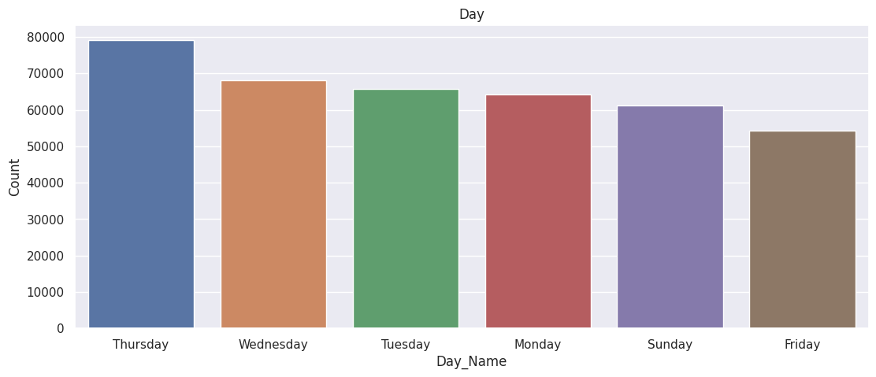
Days having highest count
We can see that most of the customers have purchased the items in Thursday, Wednesday and Tuesday.

Slide 12
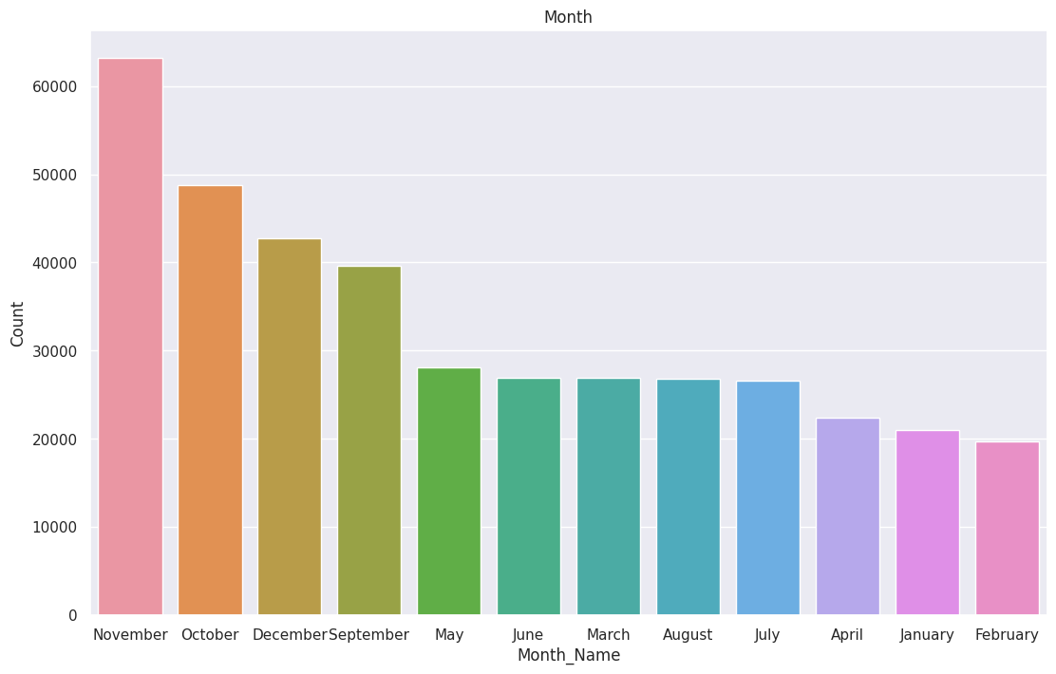
Monthly Count
From the above plot, we can see that most numbers of customers have purchased the gifts in the month of November, October, December and September. Less numbers of customers have purchased the gifts in the month of April, January and February

Slide 13
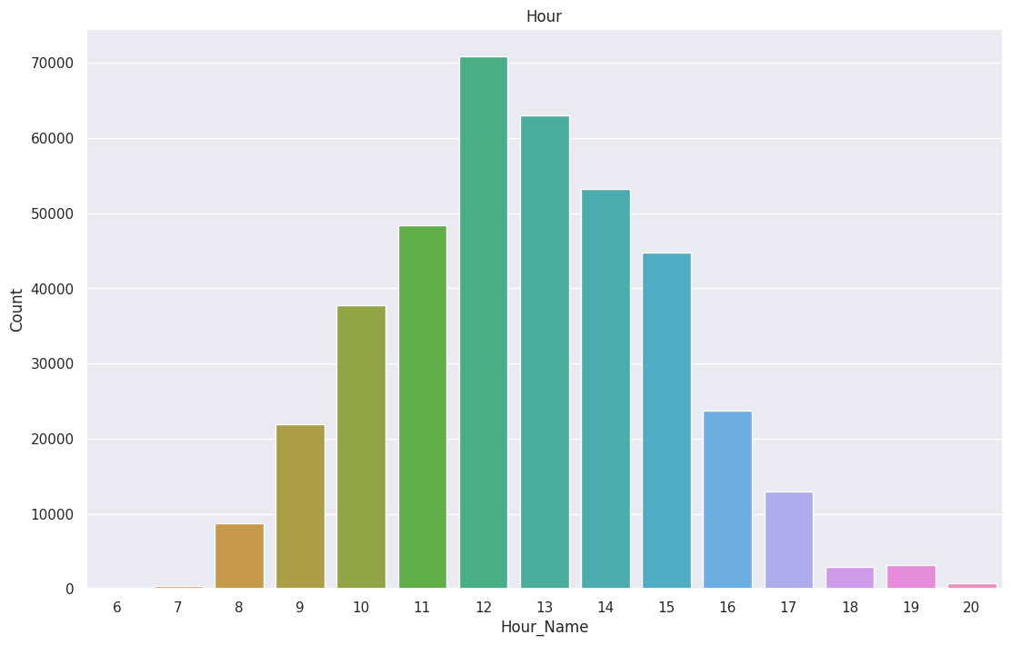
Busiest Hour
From this graph we can see that in Afternoon Time most of the customers have purchased items. 12th hour is the time where we can see most purchases.

Slide 14
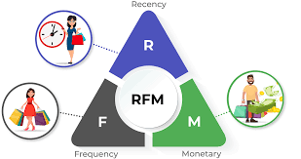
RFM Model (Recency, Frequency, Monetary value)
Recency, frequency, monetary value is a marketing analysis tool used to identify a company's or an organization's best customers by using certain measures.
The RFM model is based on three quantitative factors:
Recency – How recently did the customer purchase?
Frequency: How often a customer makes a purchase.
Monetary Value: How much money a customer spends on

Slide 15
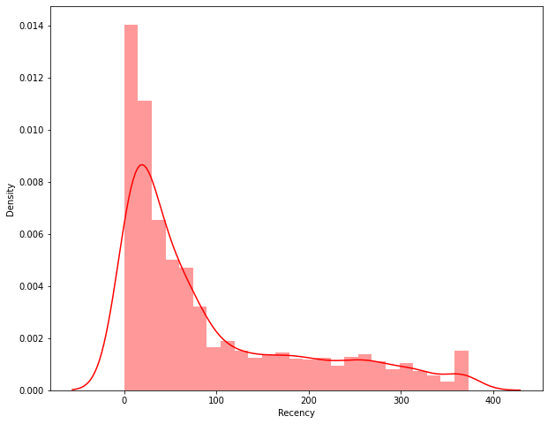
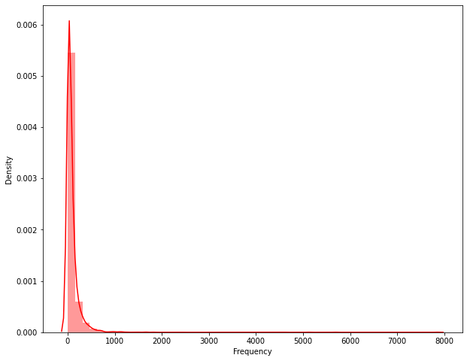
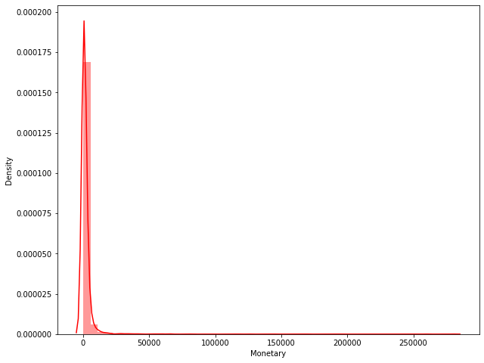
Recency, Frequency & Monetary Distribution Plots
From all the above graphs of Recency, Frequency and Monetary we can say that all are positively skewed distribution.

Slide 16
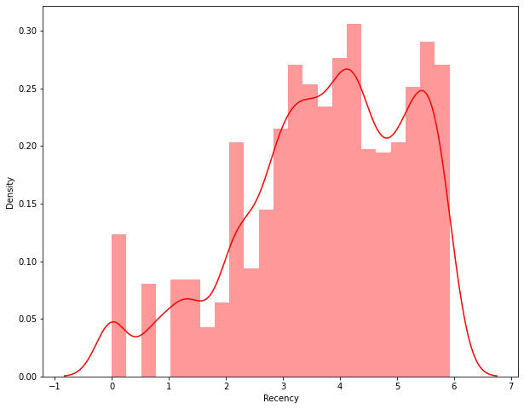
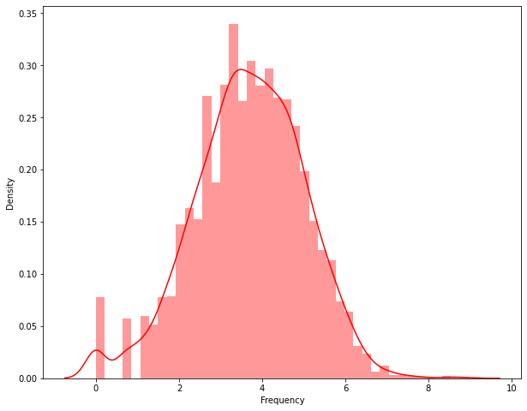
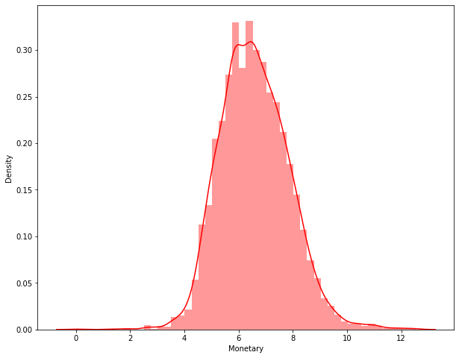
Data distribution after data normalization
We can see from the above plots, skewness has been removed from the data.

Slide 17
K-Means Clustering
Clustering is an unsupervised classification technique to understand the groups of classes in the data. We use the K-means clustering algorithm to determine the ideal segments of customers.
K-Means requires the number of clusters to be specified during the model building process. To know the right number of clusters, methods such as silhouette analysis and elbow method can be used. These methods will help in selection of the optimum number of clusters.
Silhouette score method:
Silhouette score is used to evaluate the quality of clusters created using clustering algorithms such as K-Means in terms of how well samples are clustered with other samples that are similar to each other. The Silhouette score is calculated for each sample of different clusters.

Slide 18
Applying Silhouette Score Method on Recency and Monetary
For n_clusters = 2, silhouette score is 0.4209365193373542
For n_clusters = 3, silhouette score is 0.3431262320834565
For n_clusters = 4, silhouette score is 0.36435369798998485
For n_clusters = 5, silhouette score is 0.33710394678375116
For n_clusters = 6, silhouette score is 0.3432982593130466
For n_clusters = 7, silhouette score is 0.34507565001647256
For n_clusters = 8, silhouette score is 0.33694332764708584
For n_clusters = 9, silhouette score is 0.3456119738318404
For n_clusters = 10, silhouette score is 0.3480222291727848
For n_clusters = 11, silhouette score is 0.3366893666074234
For n_clusters = 12, silhouette score is 0.3434627257801371
For n_clusters = 13, silhouette score is 0.3401793477351902
For n_clusters = 14, silhouette score is 0.34153299399103415
For n_clusters = 15, silhouette score is 0.3405026416425451

Slide 19
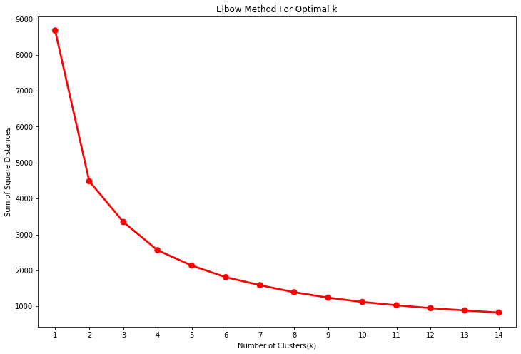
Elbow Method:
Elbow is one of the most famous methods by which you can select the right value of k and boost your model performance. We also perform the hyperparameter tuning to chose the best value of k. It is an empirical method to find out the best value of k. it picks up the range of values and takes the best among them. It calculates the sum of the square of the points and calculates the average distance.
Applying Elbow Method on Recency and Monetary

Slide 20
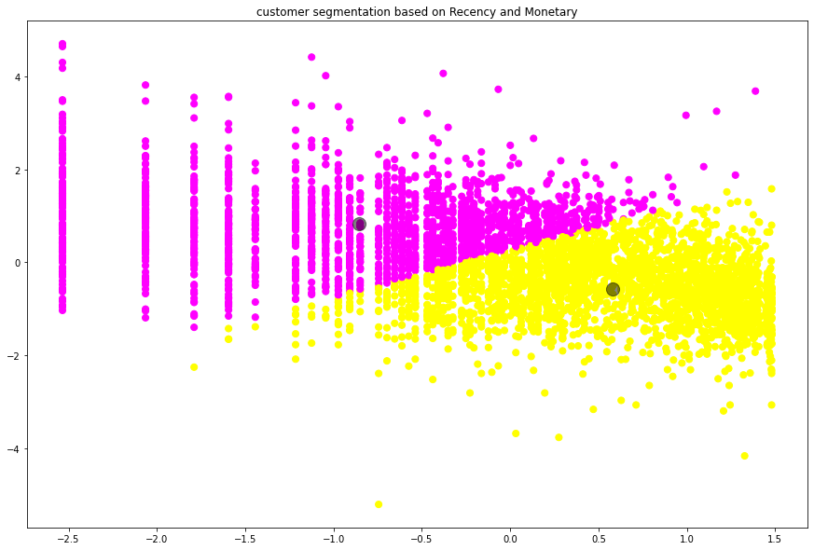
Customer segmentation based on Recency and Monetary
Here we can see that, Customers are well separated when we cluster them by Recency and Monetary.

Slide 21
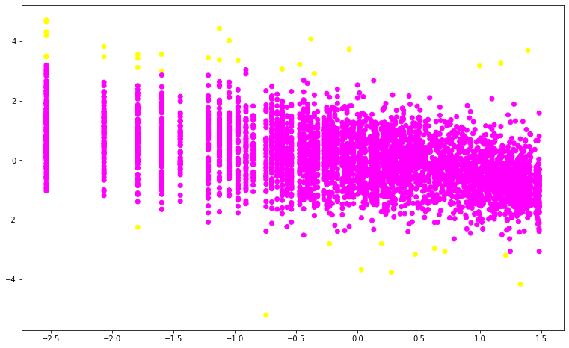
DBSCAN Clustering
DBSCAN stands for Density-Based Spatial Clustering of Applications with Noise. DBSCAN is a density-based clustering algorithm that works on the assumption that clusters are dense regions in space separated by regions of lower density. It groups ‘densely grouped’ data points into a single cluster.
Applying DBSCAN on Recency and Monetary
Here we can see that, Customers are separated when we cluster them by Recency and Monetary.

Slide 22
Applying silhouette Score Method on Frequency and Monetary
For n_clusters = 2, silhouette score is 0.4782608772260966
For n_clusters = 3, silhouette score is 0.4074955195276124
For n_clusters = 4, silhouette score is 0.3710613880101635
For n_clusters = 5, silhouette score is 0.3457454745082576
For n_clusters = 6, silhouette score is 0.3597654993555346
For n_clusters = 7, silhouette score is 0.3386790726685561
For n_clusters = 8, silhouette score is 0.3519471883583203
For n_clusters = 9, silhouette score is 0.3462612487192683
For n_clusters = 10, silhouette score is 0.36048056024834263
For n_clusters = 11, silhouette score is 0.36490416706708645
For n_clusters = 12, silhouette score is 0.34922129541844477
For n_clusters = 13, silhouette score is 0.3617844361277993
For n_clusters = 14, silhouette score is 0.3534592580324311
For n_clusters = 15, silhouette score is 0.3431237445784385

Slide 23
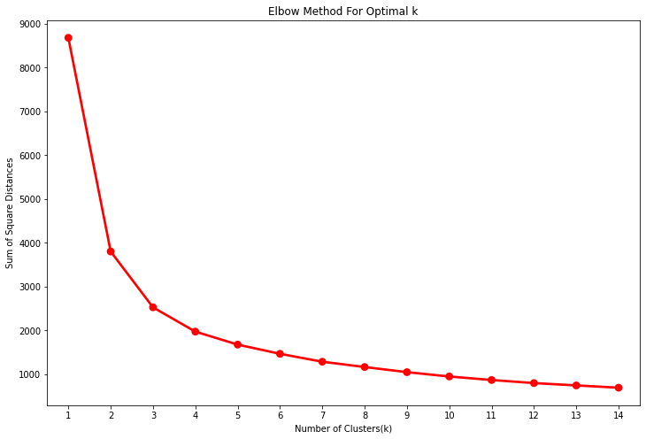
Applying Elbow Method on Frequency and Monetary

Slide 24
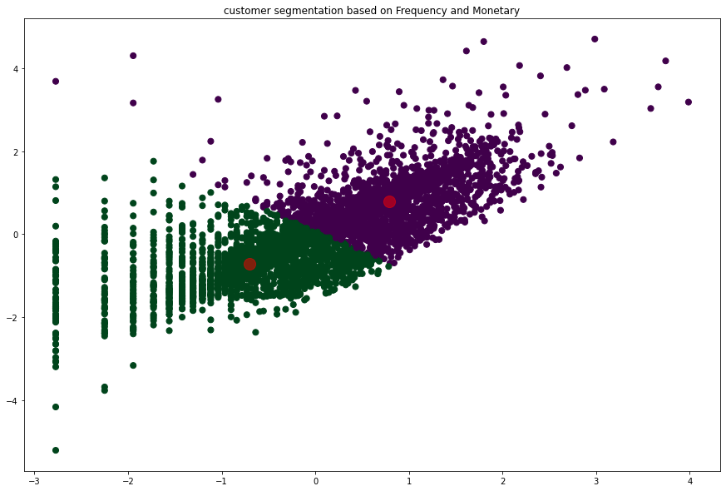
Customer segmentation based on Frequency and Monetary
Here we can see that, Customers are separated when we cluster them by Frequency and Monetary.

Slide 25
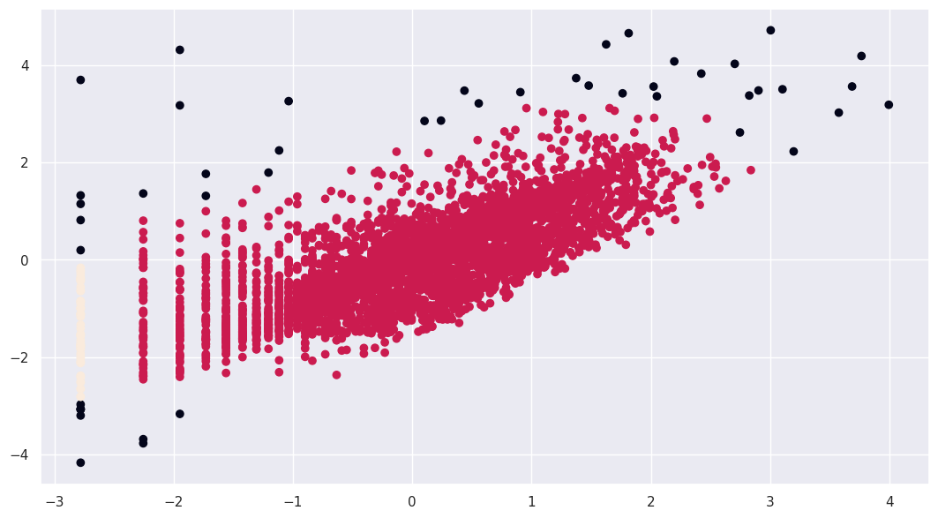
Applying DBSCAN to Method on Frequency and Monetary
So, Customers are well separated when we cluster them by Frequency and Monetary

Slide 26
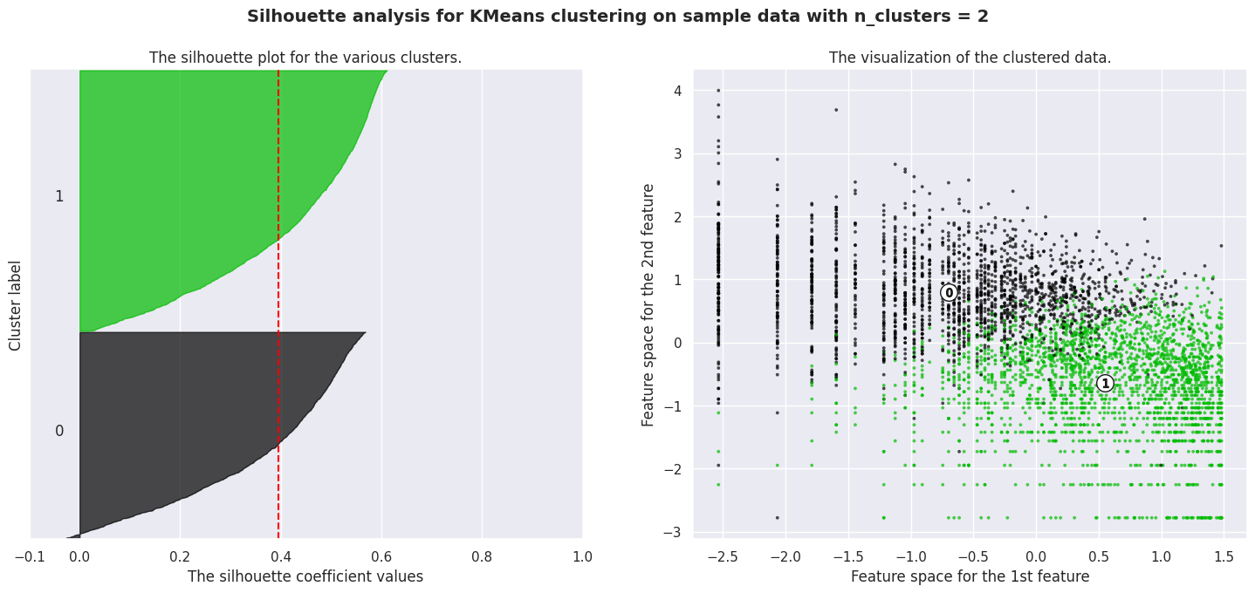
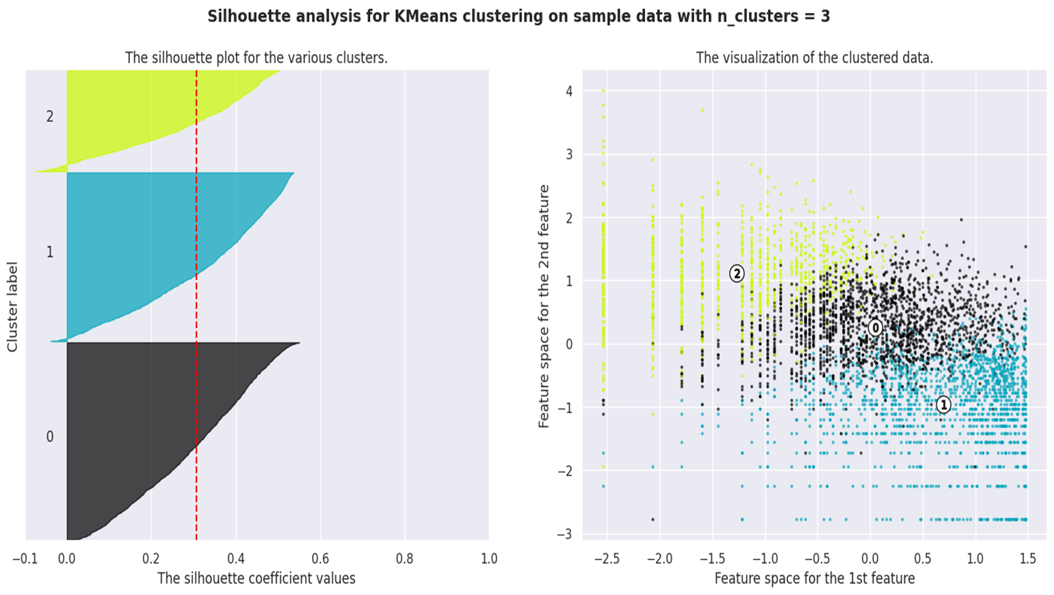
Applying Silhouette Method on Recency ,Frequency and Monetary

Slide 27
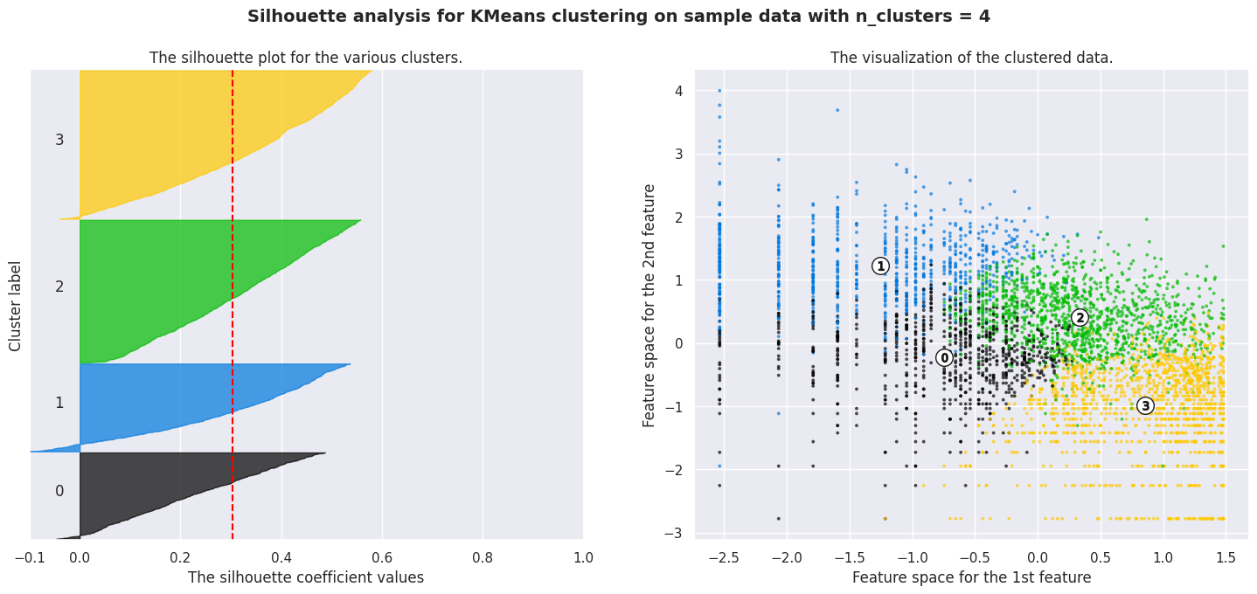
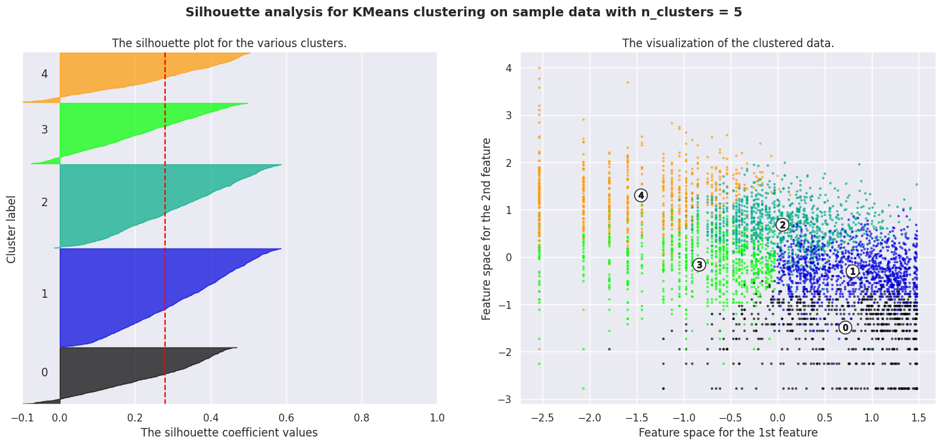

Slide 28
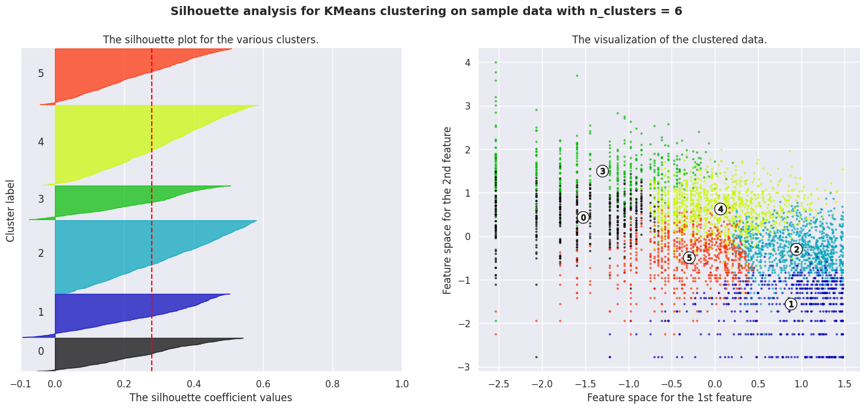
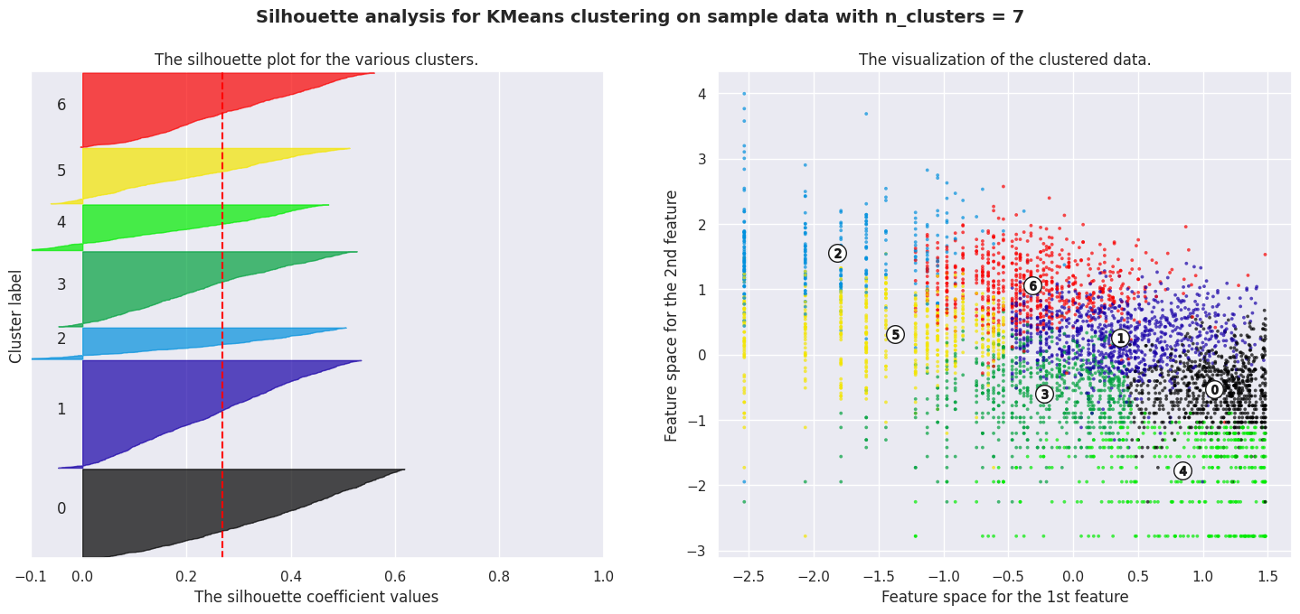

Slide 29
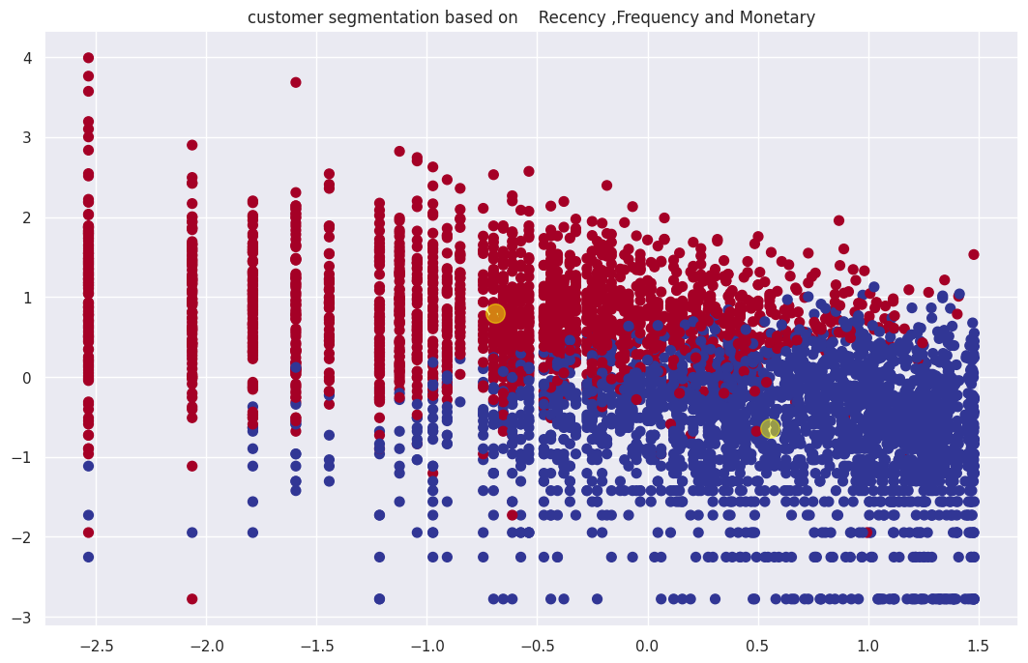
Customer segmentation based on Recency ,Frequency and Monetary

Slide 30
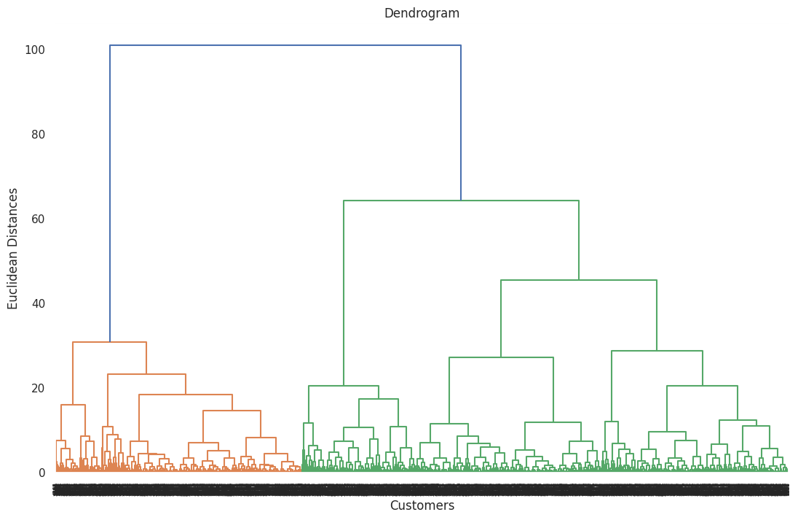
Dendrogram to find the optimal number of clusters
The number of clusters will be the number of vertical lines which are being intersected by the line drawn using the threshold=90.
Here, we can see No. of Clusters = 2

Slide 31
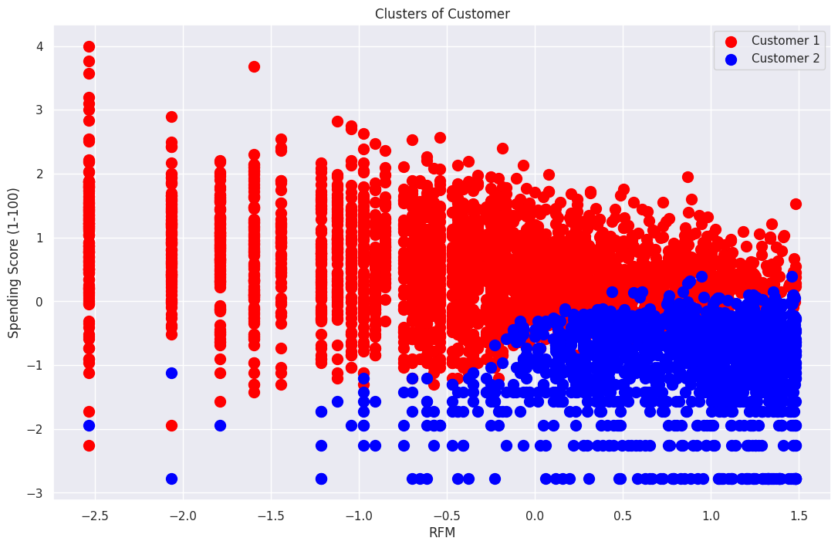
Visualizing the clusters (two dimensions only)

Slide 32
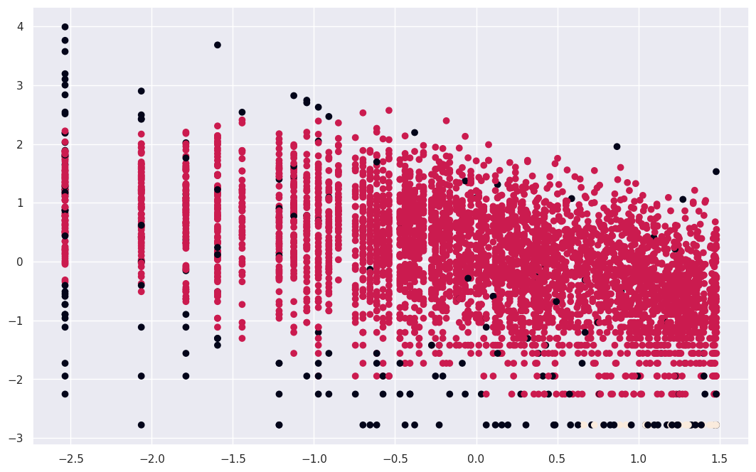
Applying DBSCAN to Recency, Frequency and Monetary

Slide 33
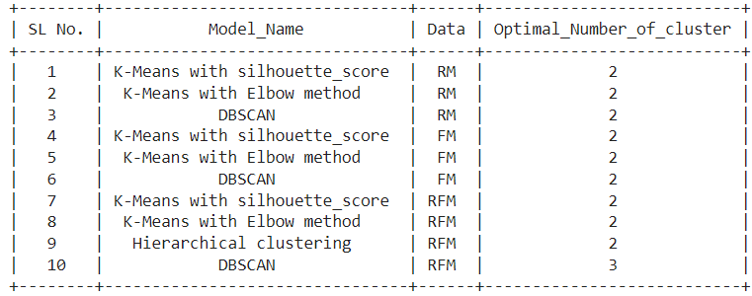
Results

Slide 34
Conclusion
1. The data exploration of Online customer segmentation dataset shows :
Missing and duplicate values were found.
Most of the purchases are from the United Kingdom.
Most of the customers have purchased items on Thursday, Wednesday, Tuesday.
Most of the customers have purchased items in November, October, December, and the least number of purchases in April, January, February.
Most of the customers purchase in the afternoon time. The 12th hour of the day is a peak for purchasing items.
2. I investigated the dataset, checked null values, duplicate values. Then getting Dataset ready for exploratory data analysis. Then I did some feature engineering, we extracted the DateTime column for getting some more useful columns. I also created the Total amount as a new variable. Thus I prepared our data for models. After that, I created an RFM model (Recency, Frequency, Monetary value). I did a log transformation of R, F, M for better results.
3. Now comes the model-building part, I used the K-Means clustering algorithm to find the optimal number of clusters that can separate customers based on their purchasing behavior, then applied the K-Means algorithm with the Silhouette Score Method on RM, FM, RFM simultaneously. Where I got the optimal number of clusters = 2. I then visualized our results with scatterplots. Then moving forward I applied K-Means with Elbow Method on RM, FM, RFM simultaneously. Next, I applied DBSCAN on RM, FM, and RFM where we got the optimal number of clusters as 2, 2, 3 simultaneously. After that, I applied Dendrogram to find the optimal number of clusters..
So, by applying various algorithms, optimal number of cluster is equal to 2.

Slide 35
Thank you!!

